Slide 1
What is Psychiatry?
8 Years in 30 Minutes

Slide 2
Human Existence
Spiritual
Universal in all Cultures (neurologic?)
Species
Vestigial Anatomy and Behaviors (SAD)
Evolutionary
Rocket Science vs Connectedness
Substances
Psychiatric
Disorders
Mutual Impact on Planet

Slide 3
Building Blocks of Being
Values
Morals
“Normal”
Interpersonal
How fit in world
Illness
Pain
Medications
Disability
Compliance/Care
Sleep Disorders
Development
of personality
Physical condition
Impact
Physical
Psychiatric
Legal
Social
Financial
Mood
Reality
Anxiety
Neurocognitive
Somatoform
Psychiatric
Disorders
Substances

Slide 4
Historical Milestones of Psychiatry
Ancient
evil, possessed, etc
Middle Ages
Middle East beginnings of psychiatric “hospitals” in 9th century
Psychoanalysis late 1800’s
Freud established mental illness stems from childhood experiences
Beginnings of psychopharmacology
Mid 50’s lithium, Thorazine (typical antipsychotics)
Early 60’s tricyclic antidepressants
Mid 80’s Prozac, Clozaril (atypical antipsychotics)
2000’s TMS, ketamine
Future
Genetic cures

Slide 5
Psychiatric Illness Exaggeration of Normal
Normal Disorder
sadness/grief depression/suicidality
happiness mania
shy/reserved social anxiety
imaginative psychosis
forgetful dementia
scattered ADHD
episodic physical ailments somatoform disorders
diet eating disorder

Slide 6
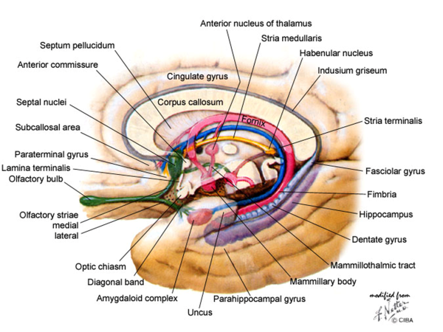
Modern Psychiatry
Interaction of all areas of human existence
Pure psychiatric illnesses seen as increasingly neurophysiologic
Schizophrenia vs Parkinson’s
Most psychiatric medications re-locate, block, augument or create neurotransmitters and/or receptors at the synapse

Slide 7
Now finally time for…
Questions?

