Slide 1
Collegiate Performance Nutrition
Jordan Jennewine MS, RD, LD, CSSD
Notes:
Former college track athlete, UMD Olympic sports/football dietitian (3 yrs), contact dietitian UD athletics (1 year), OSU performance dietitian

Slide 2
Performance Nutrition Experience
Masters in Clinical Nutrition – The Ohio State University
Certified Specialist in Sports Dietetics
University of Maryland Performance Dietitian – Olympic sports and football
University of Dayton Contract Dietitian – Men’s and Women’s Basketball
The Ohio State University Performance Dietitian – M/W Ice Hockey and M/W Basketball

Slide 4
Time and Balance
Class schedules, training schedules, lifting schedules, rehab, jobs/volunteering, social time
Planning ahead
Proper nutrient timing to support activity and recovery

Slide 7
A day in the life…
5:45am: wake up & pre-workout meal/snack
6:30am: arrive at rink
7-9am: team skate/practice
9-9:30am: goalie session
9:45-10:45am: team lift/on-ice conditioning
11-12:30pm: meal available at rink
1-1:50pm: class
3-4:05pm: class
5pm: rink for extra shooting practice
6:30pm: home for evening (dinner, homework, etc)

Slide 8
Food Availability & Knowledge
Team budget, scholarships
Varying experience with nutrition
Allergies and varying food preferences

Slide 9
4 Pillars of Nutrition
1
EDUCATION
2
COUNSELING
.
3
4
GAME DAY/ TRAVEL NUTRITION
FOOD SERVICE
.
.

Slide 10
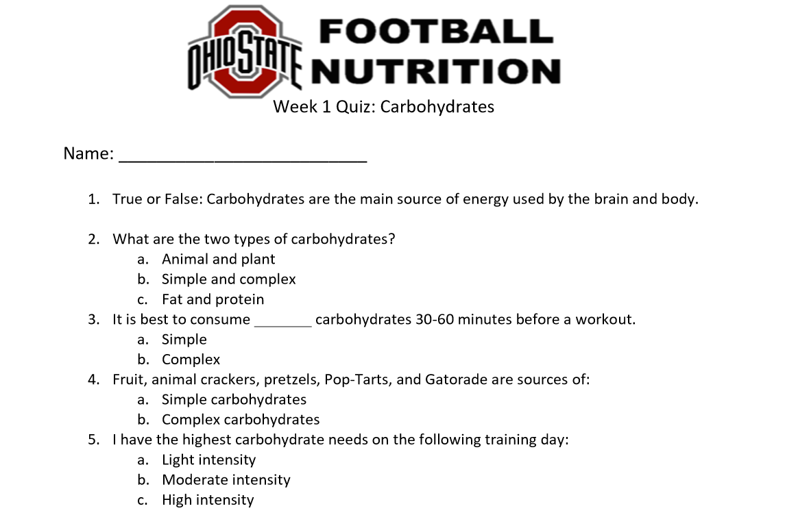
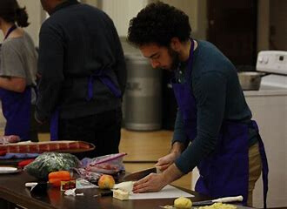
Team Education
Themed-based quizzes
Cooking demos

Slide 11
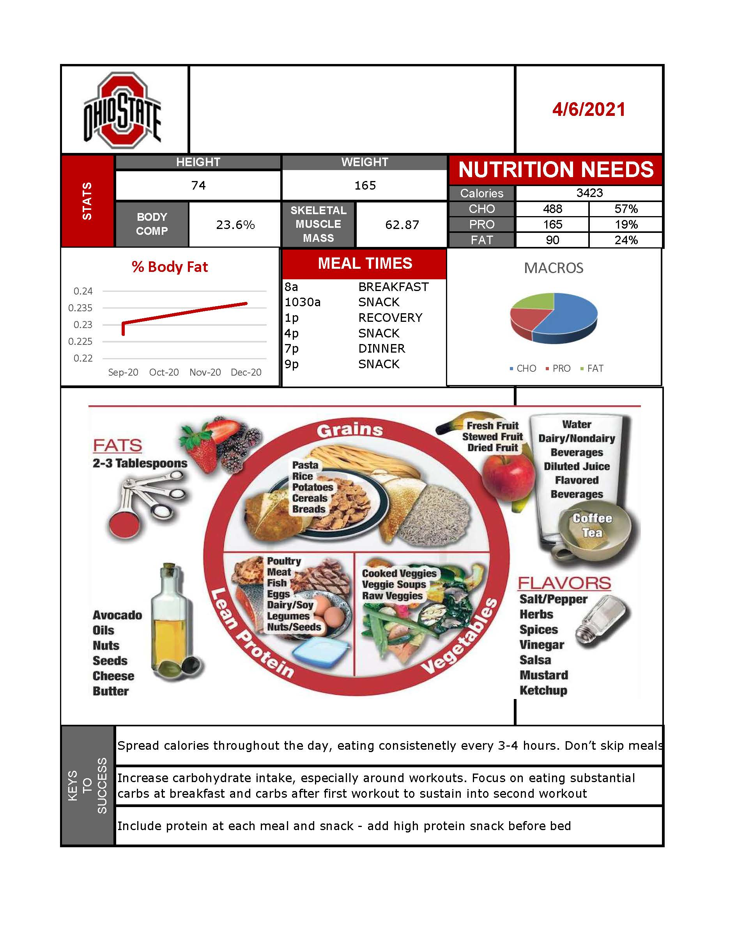
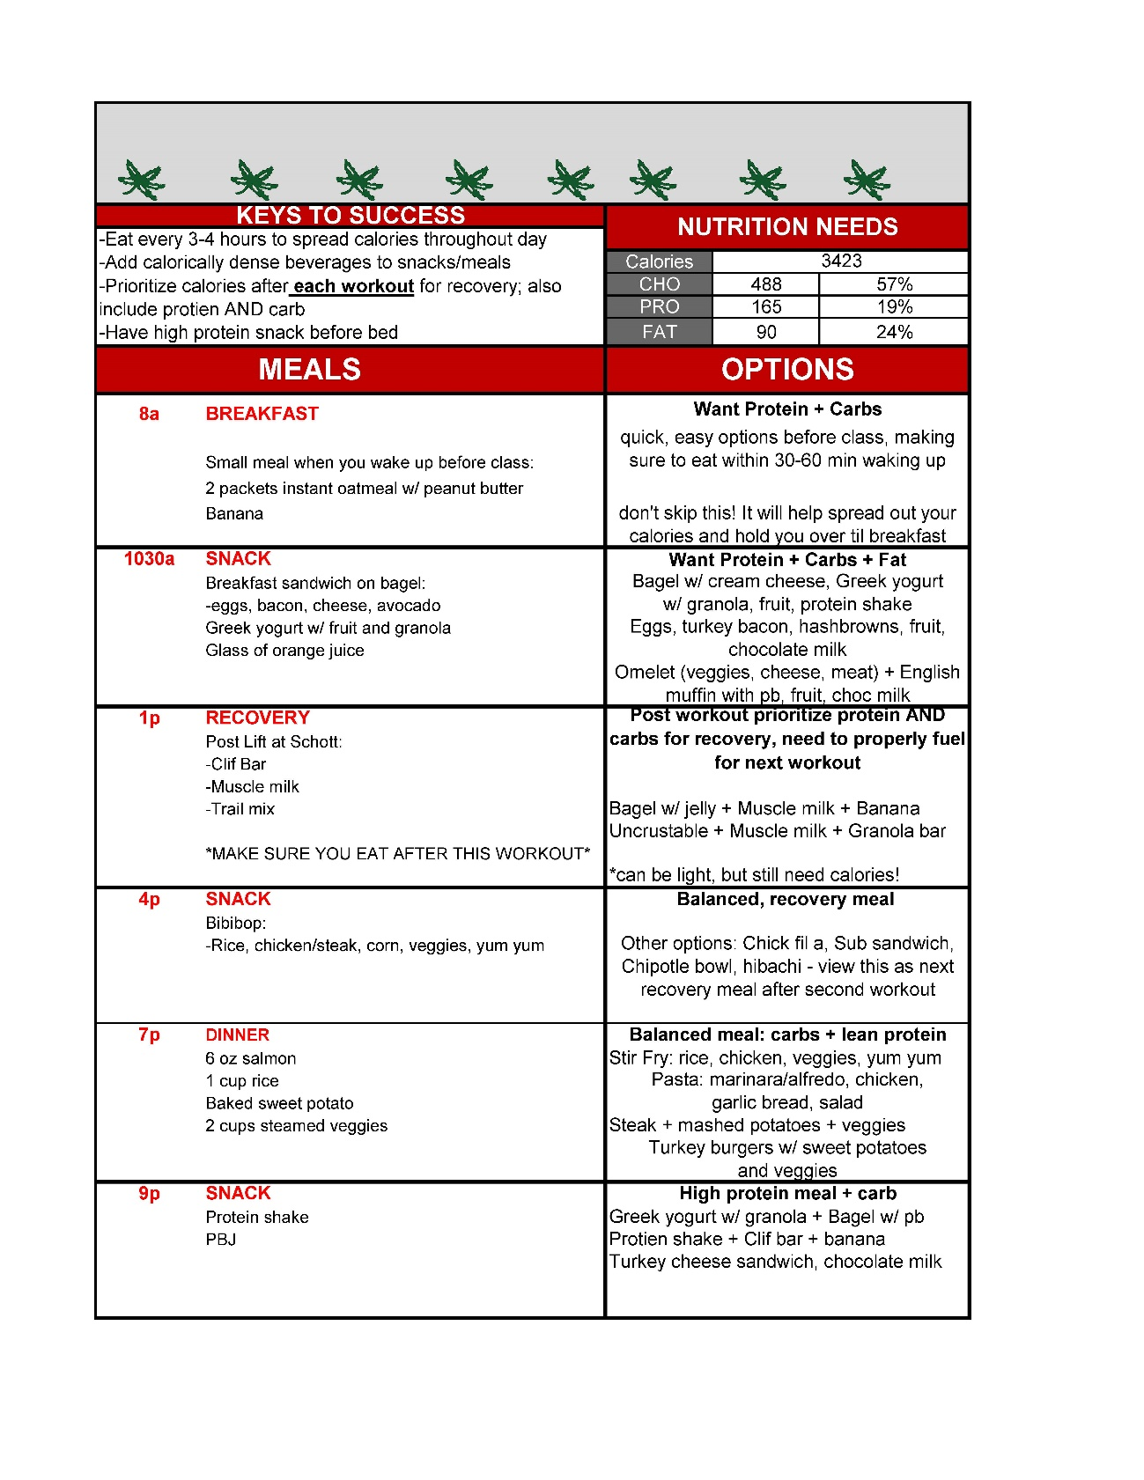
Individualized Nutrition

Slide 12
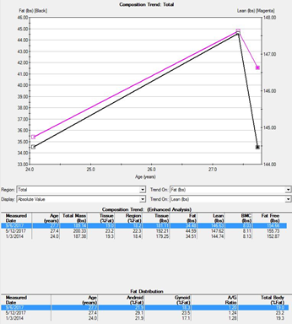
Body Composition
-Team uses a DEXA machine
X –ray machines that will give the performance team body fat percentage, lean mass, fat mass, bone density, segmented lean mass, etc
-Performance team uses this for weight goals

Slide 13
Supplement Safety
Always talk with a professional before using supplements
Supplements will not fix a poor diet
Look for third party testing to ensure accurate ingredients

Slide 14
QUESTIONS?
Contact info:
Jordan Jennewine
Jennewine.2@osu.edu

