Slide 1
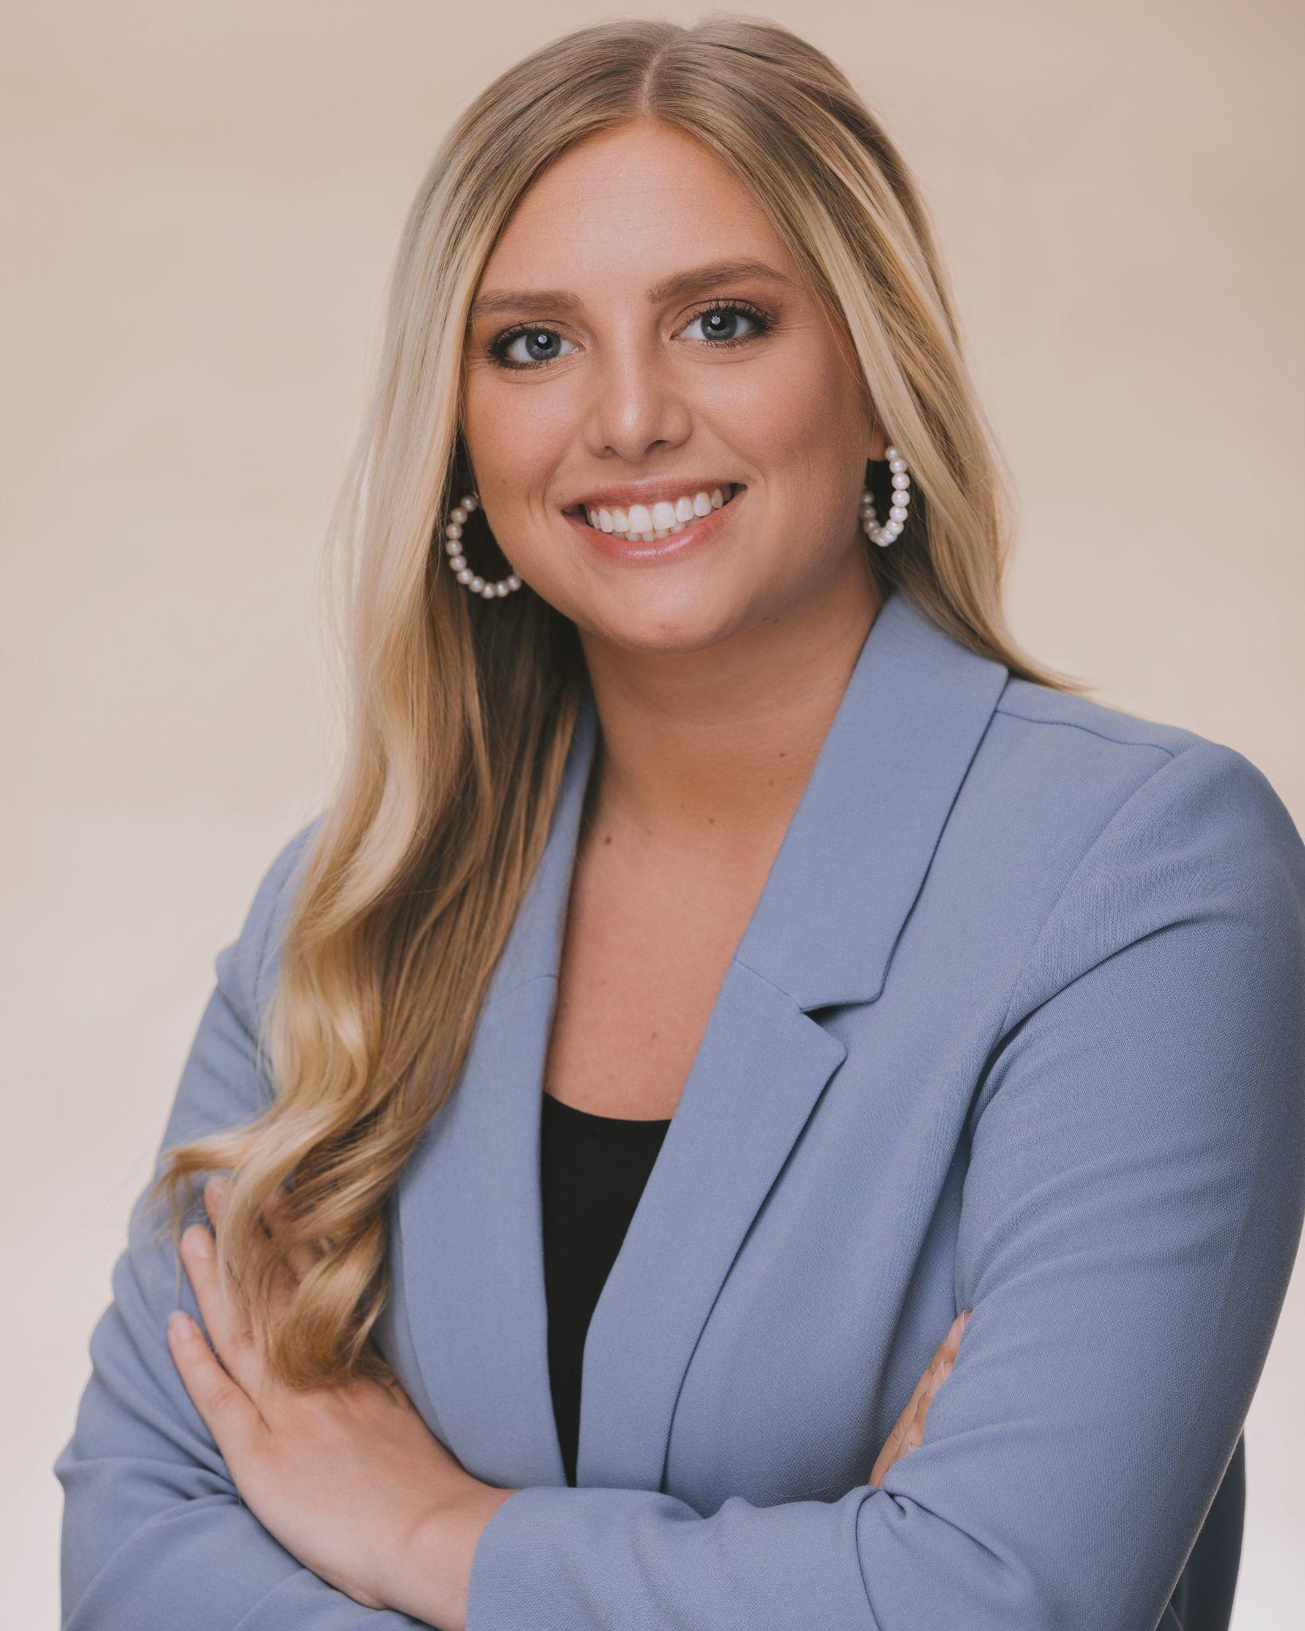
Olivia G. Kilby
Attorney at Law
Olivia G. Kilby
Attorney at Law

Slide 2
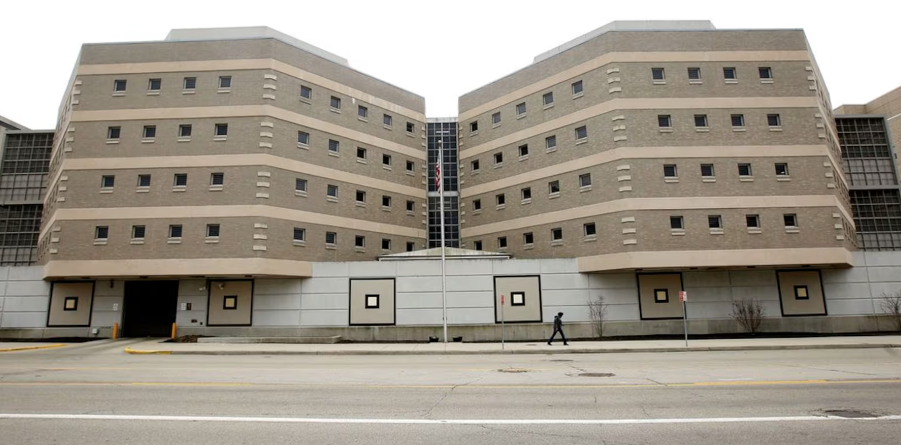
Criminal defense attorney
Currently practicing at the Montgomery County Public Defender’s Office in downtown Dayton.
I represent indigent individuals who are accused of a crime that could result in a jail sentence.
Montgomery County Jail
Some other law practice areas: intellectual property, corporate law, family law, environmental law, tax law, immigration law, bankruptcy, civil law, health law, property law, personal injury, civil and political rights, construction law, estate planning, and more.

Slide 3
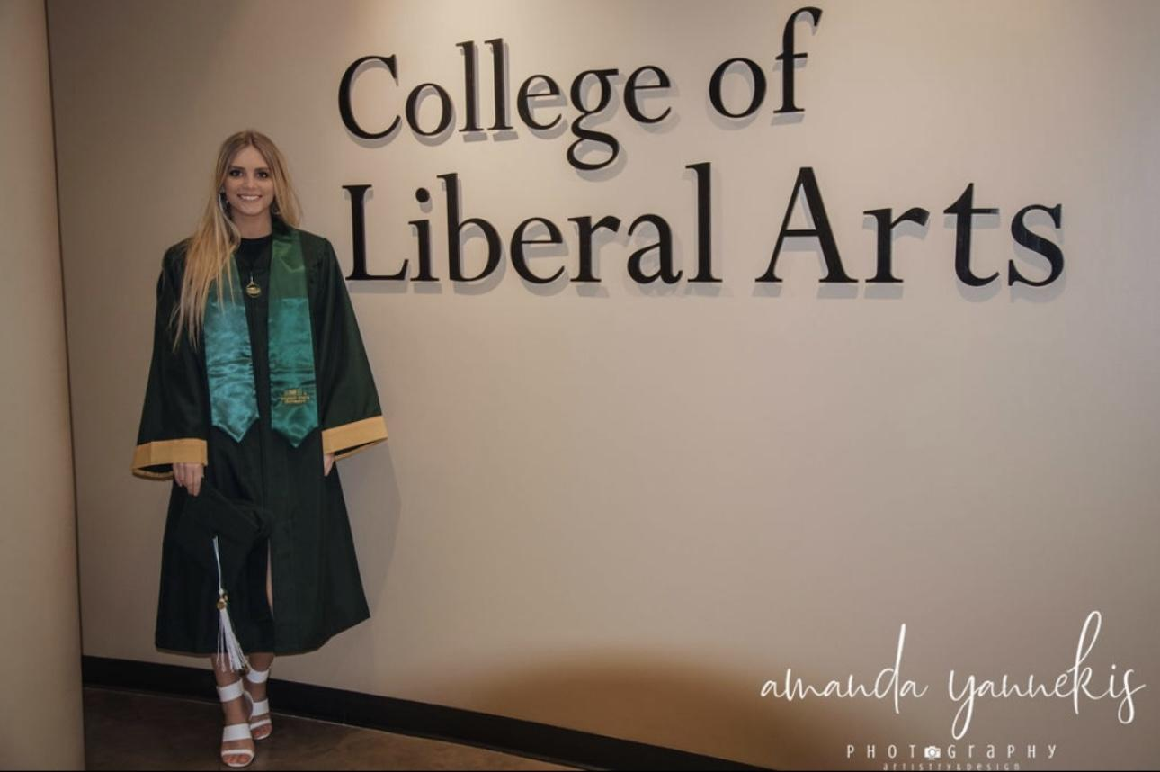
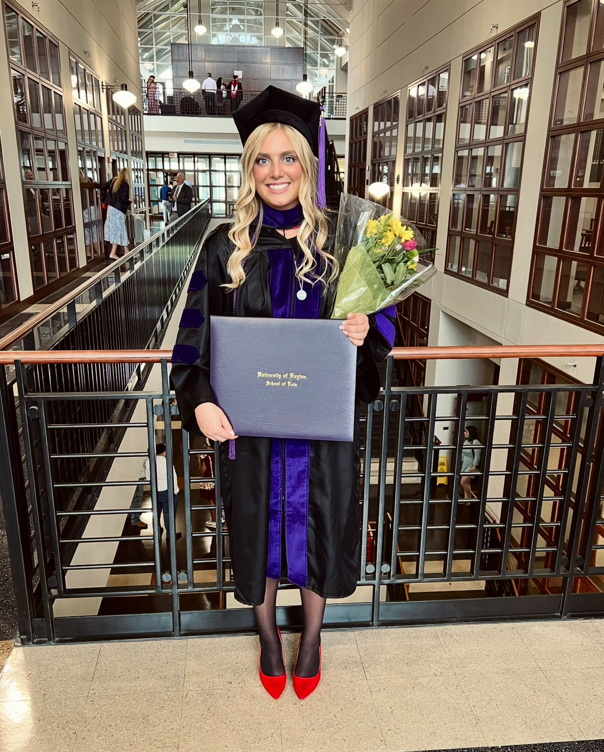
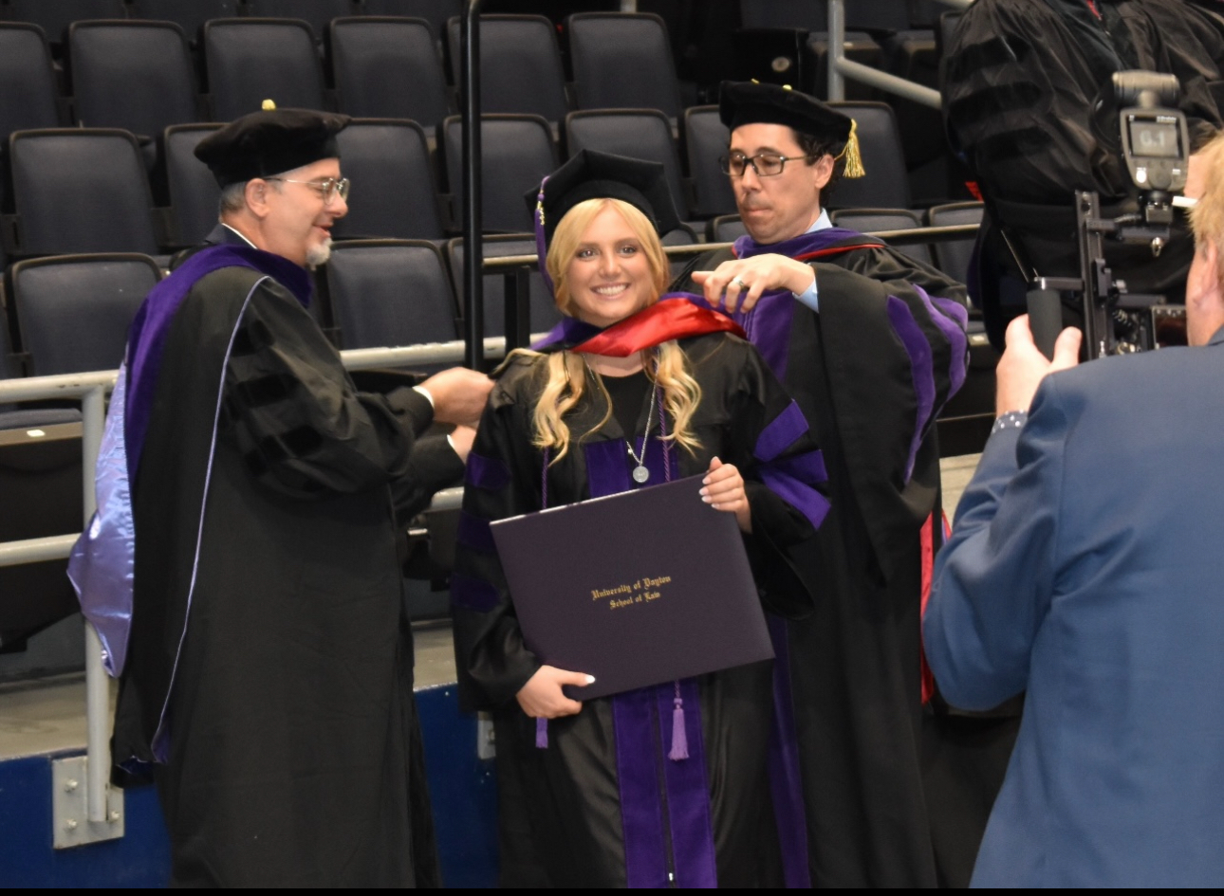
Associate of Arts Degree in Liberal Studies: Sinclair Community College
Bachelor of Arts Degree in Political Science & minor in Legal Studies: Wright State University
Doctor of Jurisprudence: University of Dayton School of Law
Just need ONE bachelor's degree (4 year degree) in ANY subject in order to apply for law school
Law school is 3 years
Why PoliSci?

Slide 4
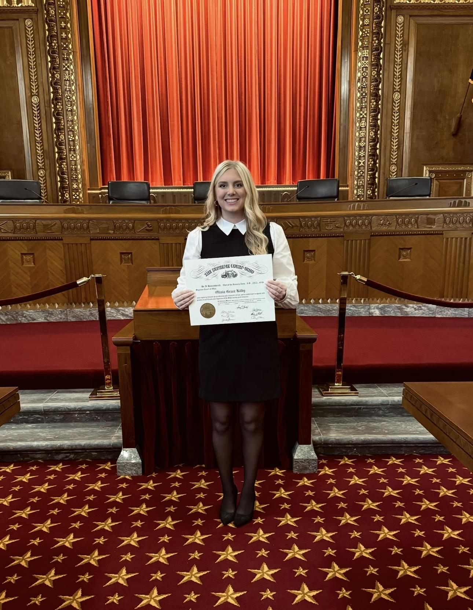
Timeline:
2016: Graduated CHS
2019: (May) Graduated Wright State & Sinclair (3 years)
2019-2020: “Gap” year: Studied for law school admission test (LSAT)/ Took LSAT/ Covid
2020: (August) Started law school
2023: (May) Graduated law school
2023: (July) Took BAR exam
2023: (October) Sworn in as licensed attorney
2023-Now: Public Defender
Supreme Court of Ohio swearing in ceremony
Fun fact: While often used interchangeably, an "attorney" is a lawyer who is licensed to practice law and represent clients in court, while a "lawyer" has completed law school but may not be licensed.

Slide 5
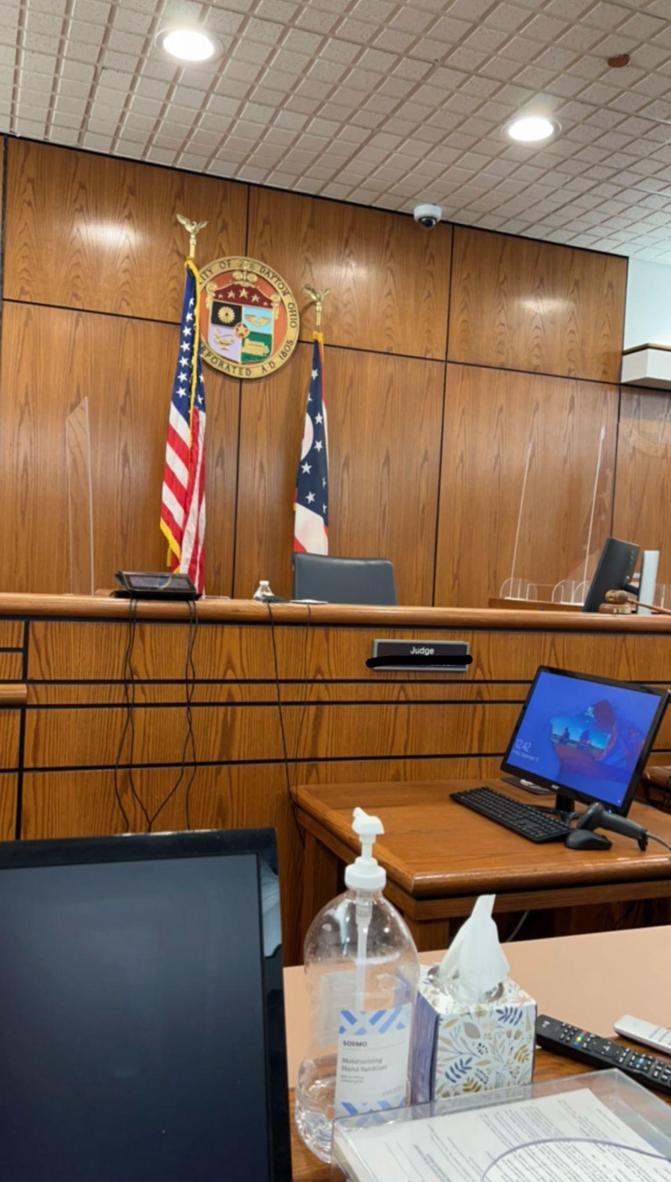
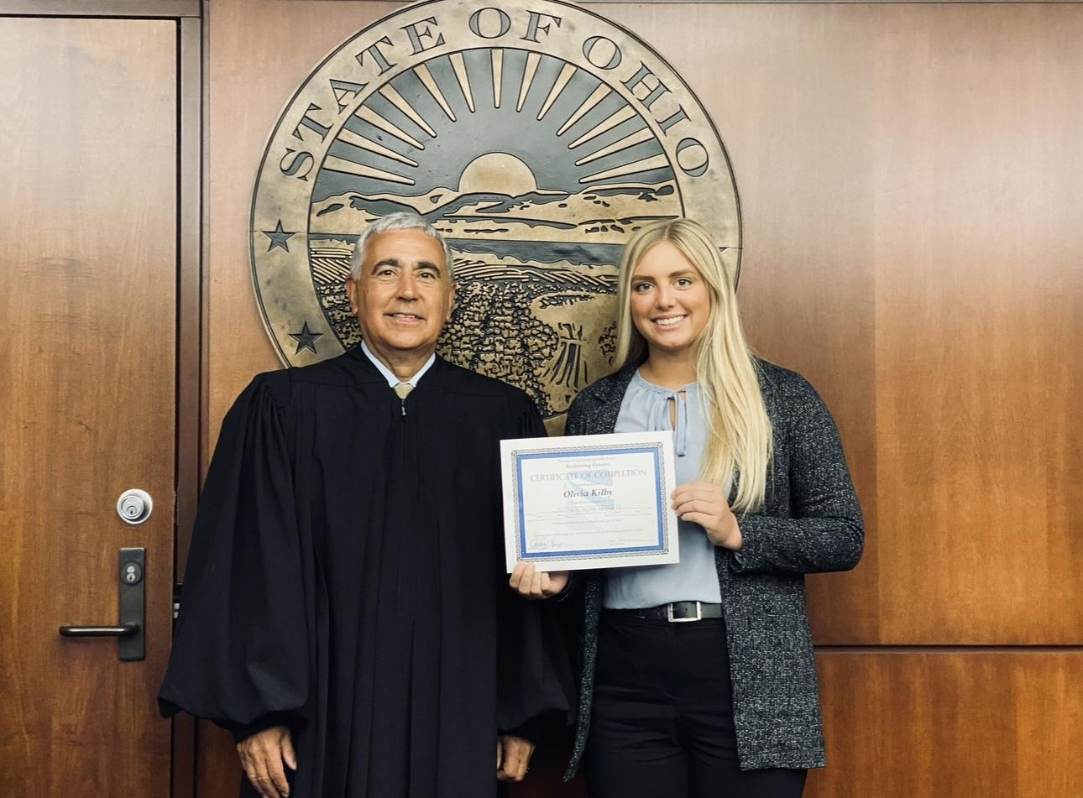
My Biggest Advice: When deciding what you want to do really think about your strengths and weaknesses. What is your overarching goal in life? What are you good at? What do you dislike? What is a hobby? Remember: you don’t have to decide right now!
Questions?

